Slide 1
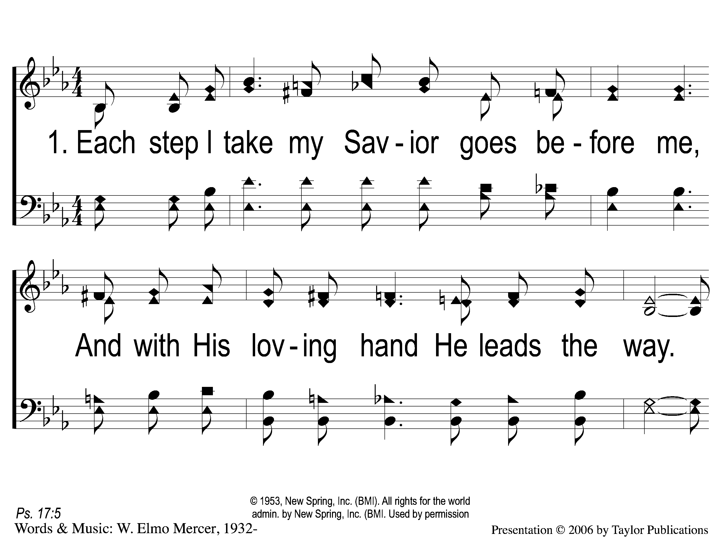
1-1 Each Step I Take
Each Step I Take
94

Slide 2
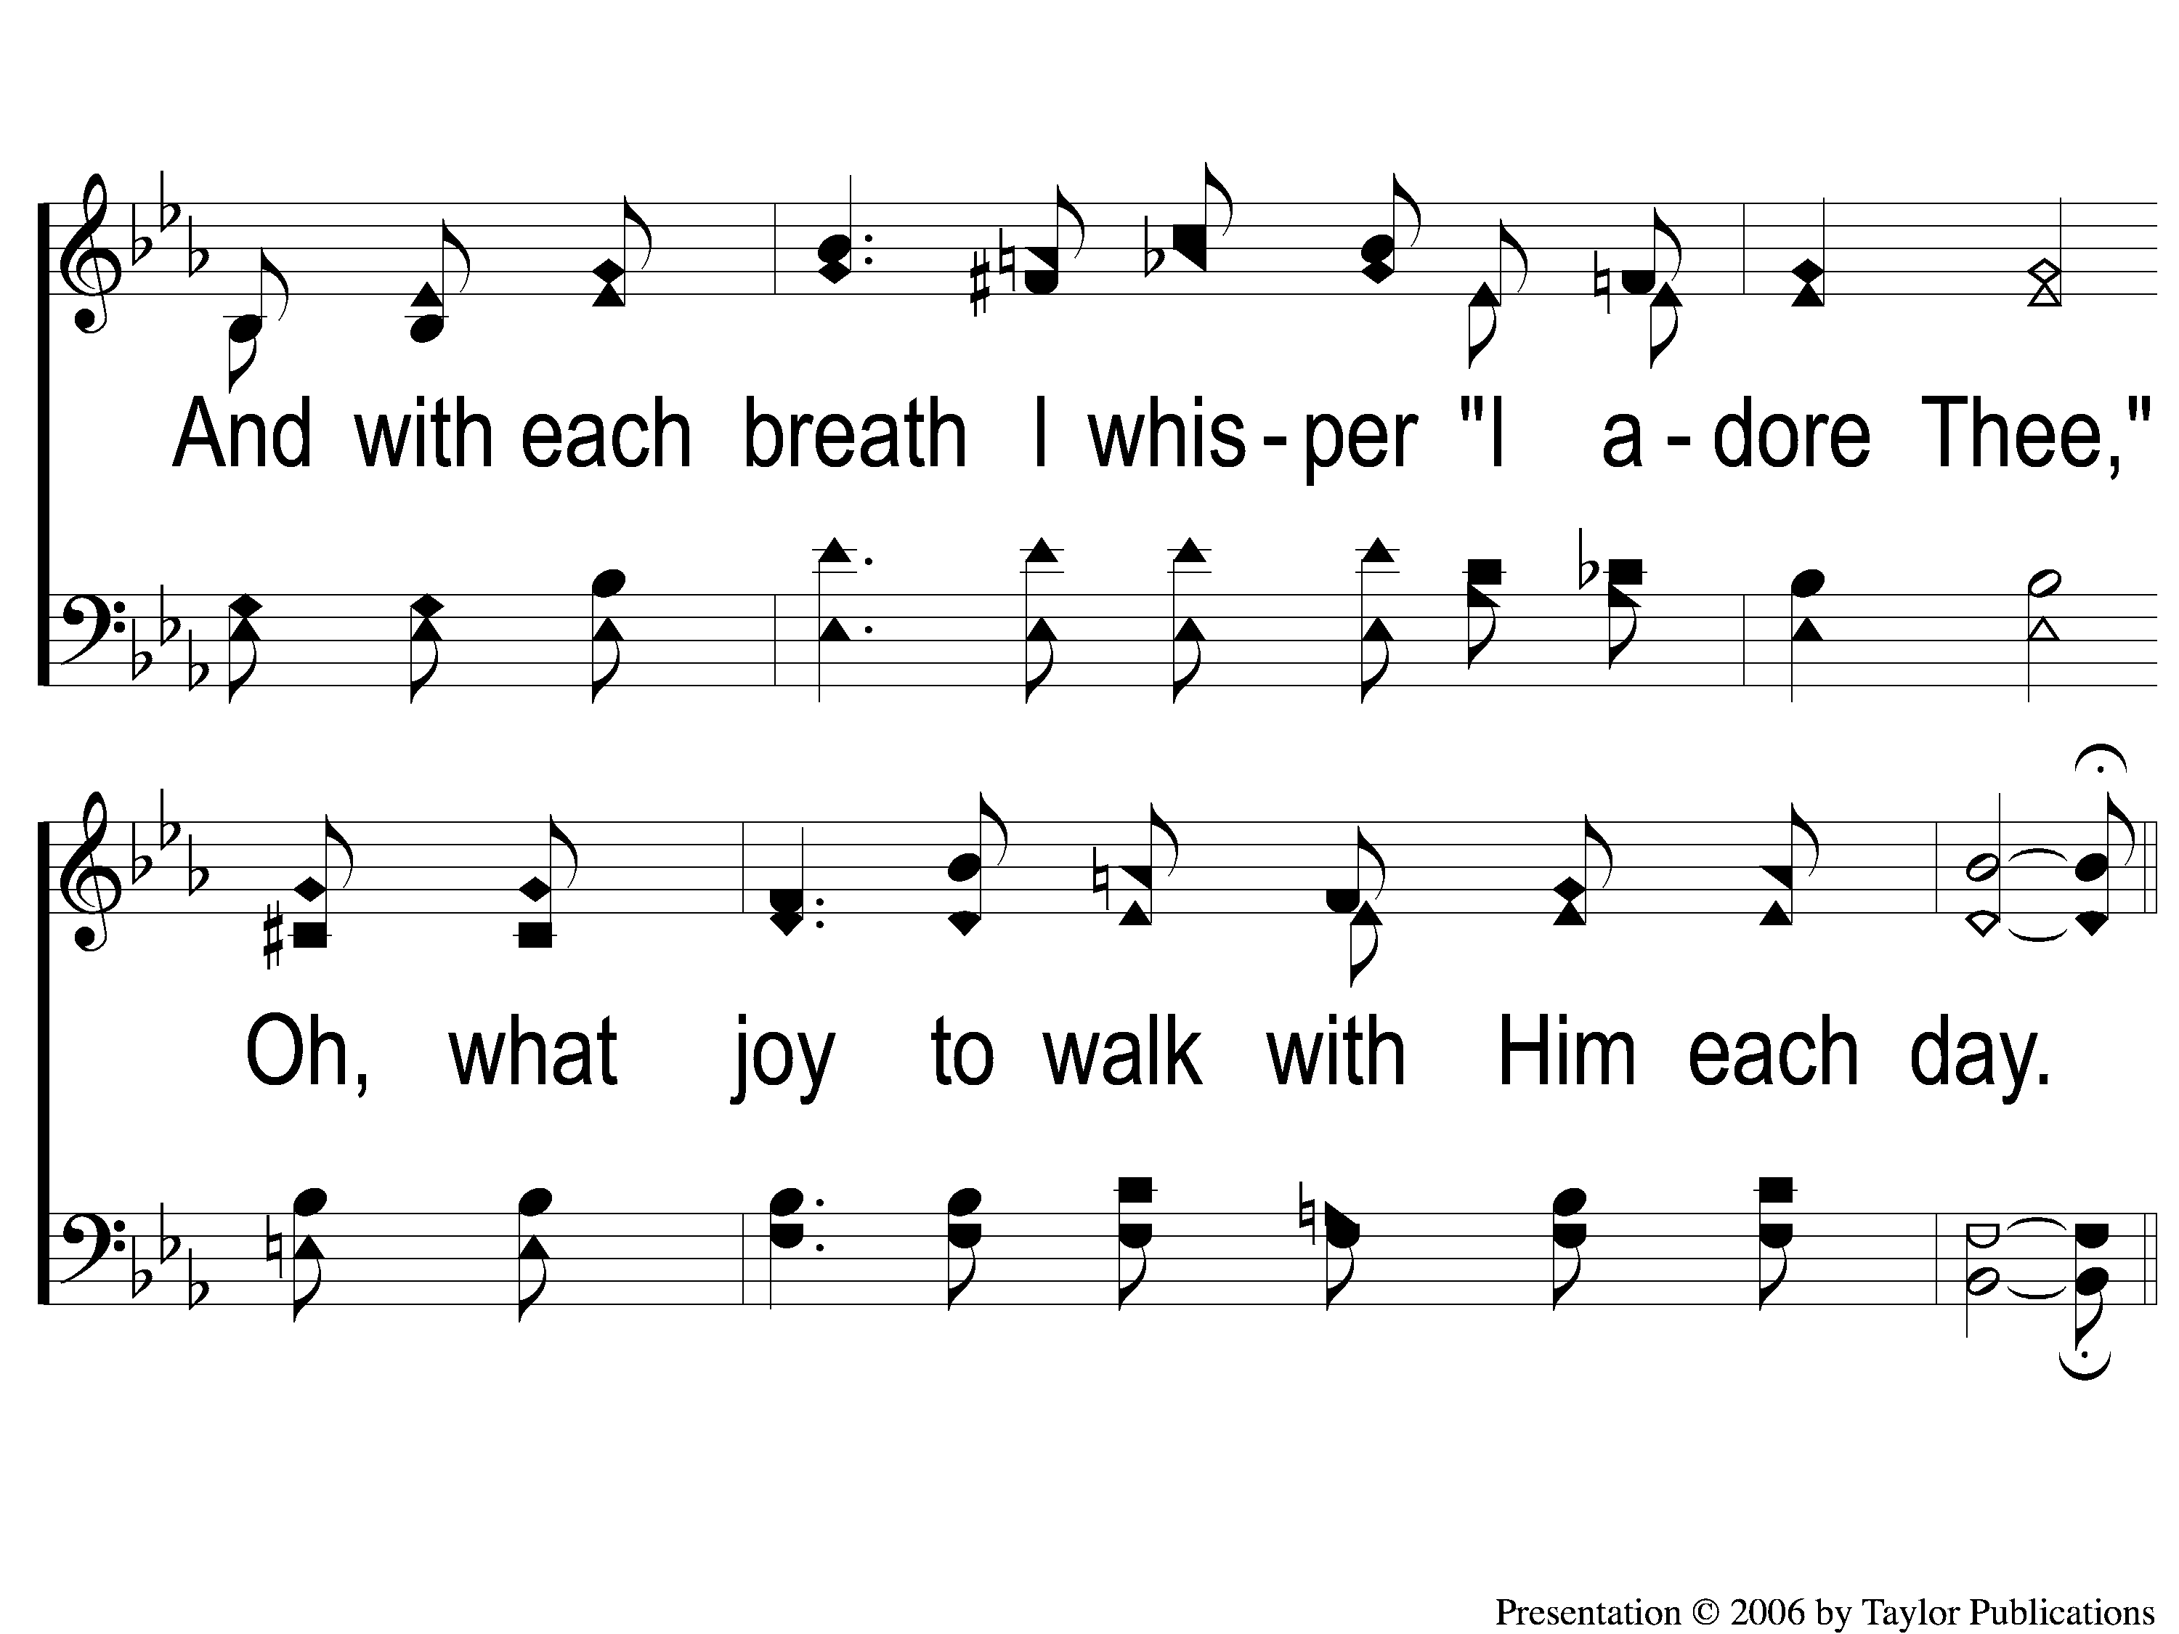
1-2 Each Step I Take
Each Step I Take
94

Slide 3
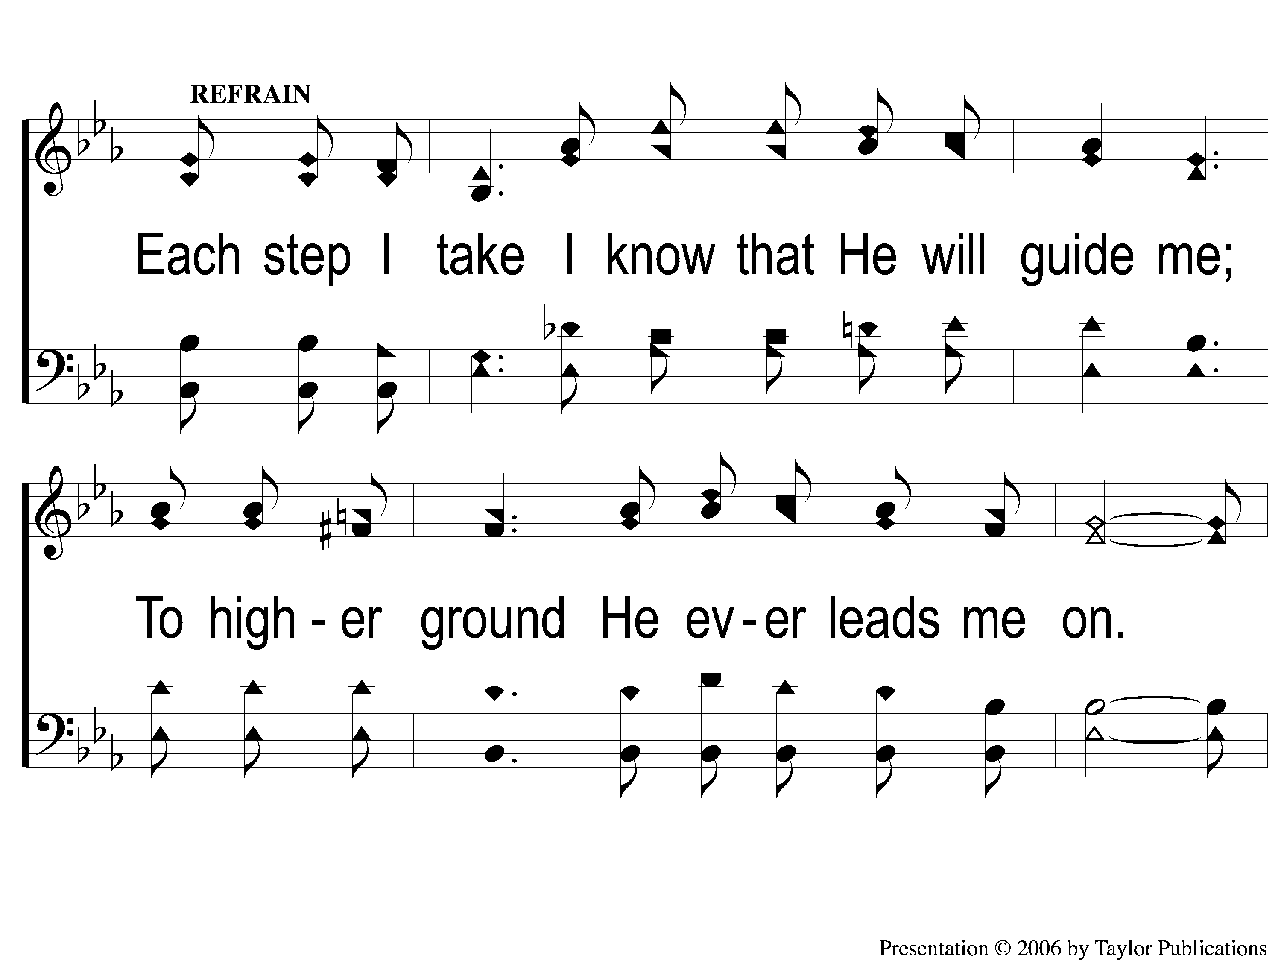
C-1 Each Step I Take
Each Step I Take
94

Slide 4
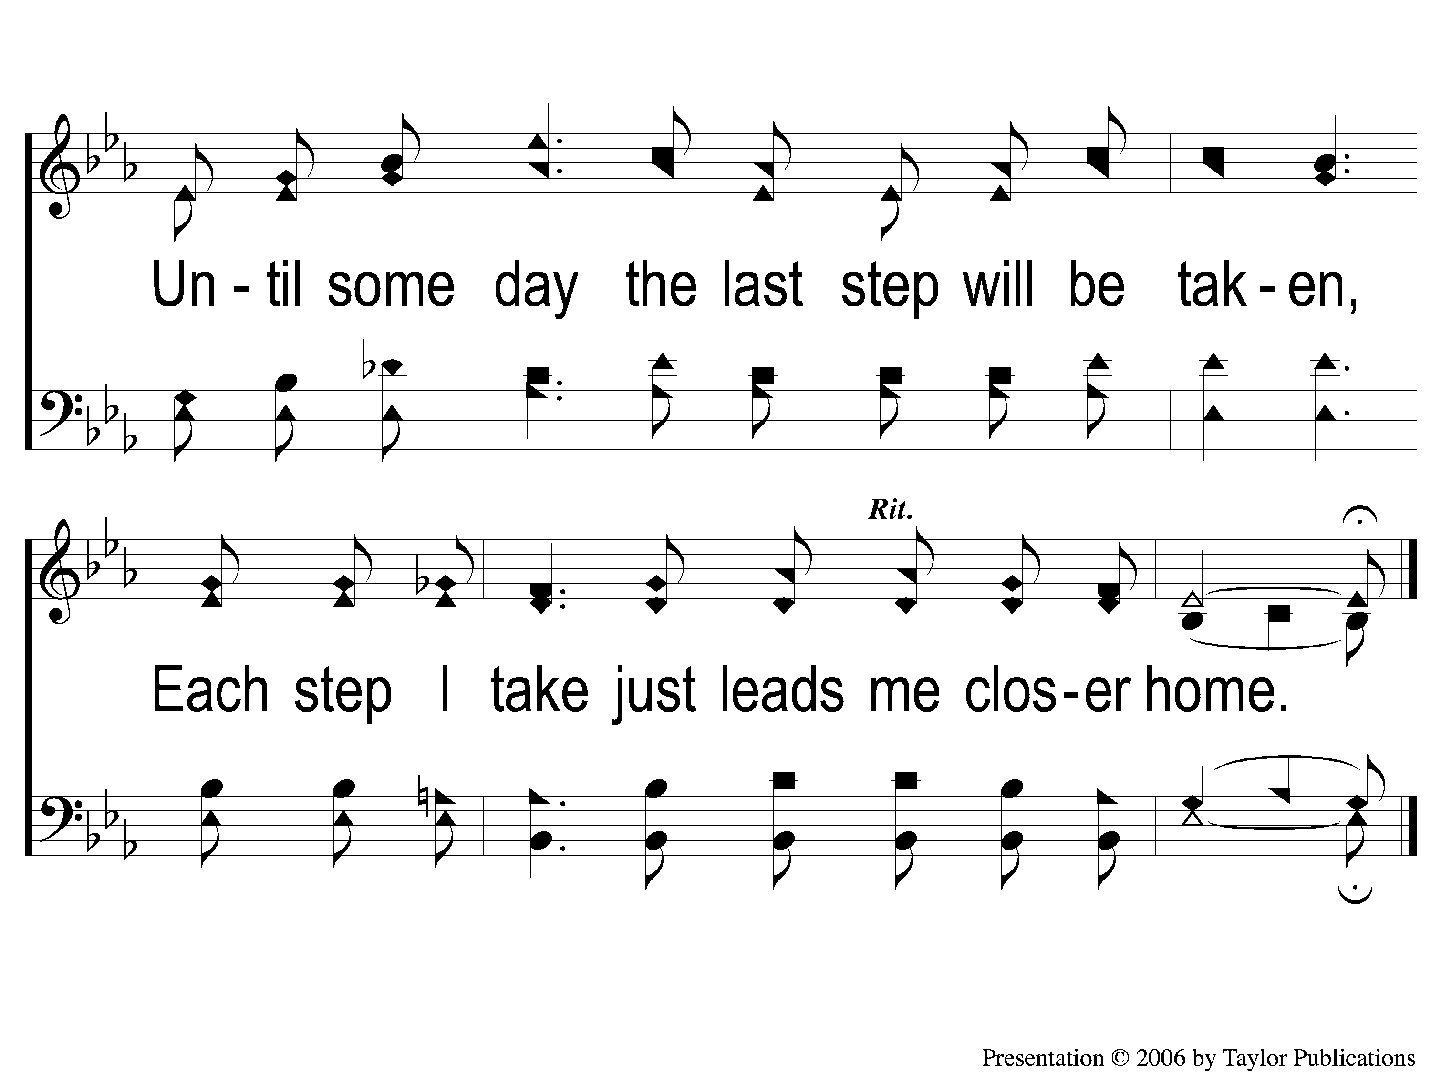
C-2 Each Step I Take
Each Step I Take
94

Slide 5
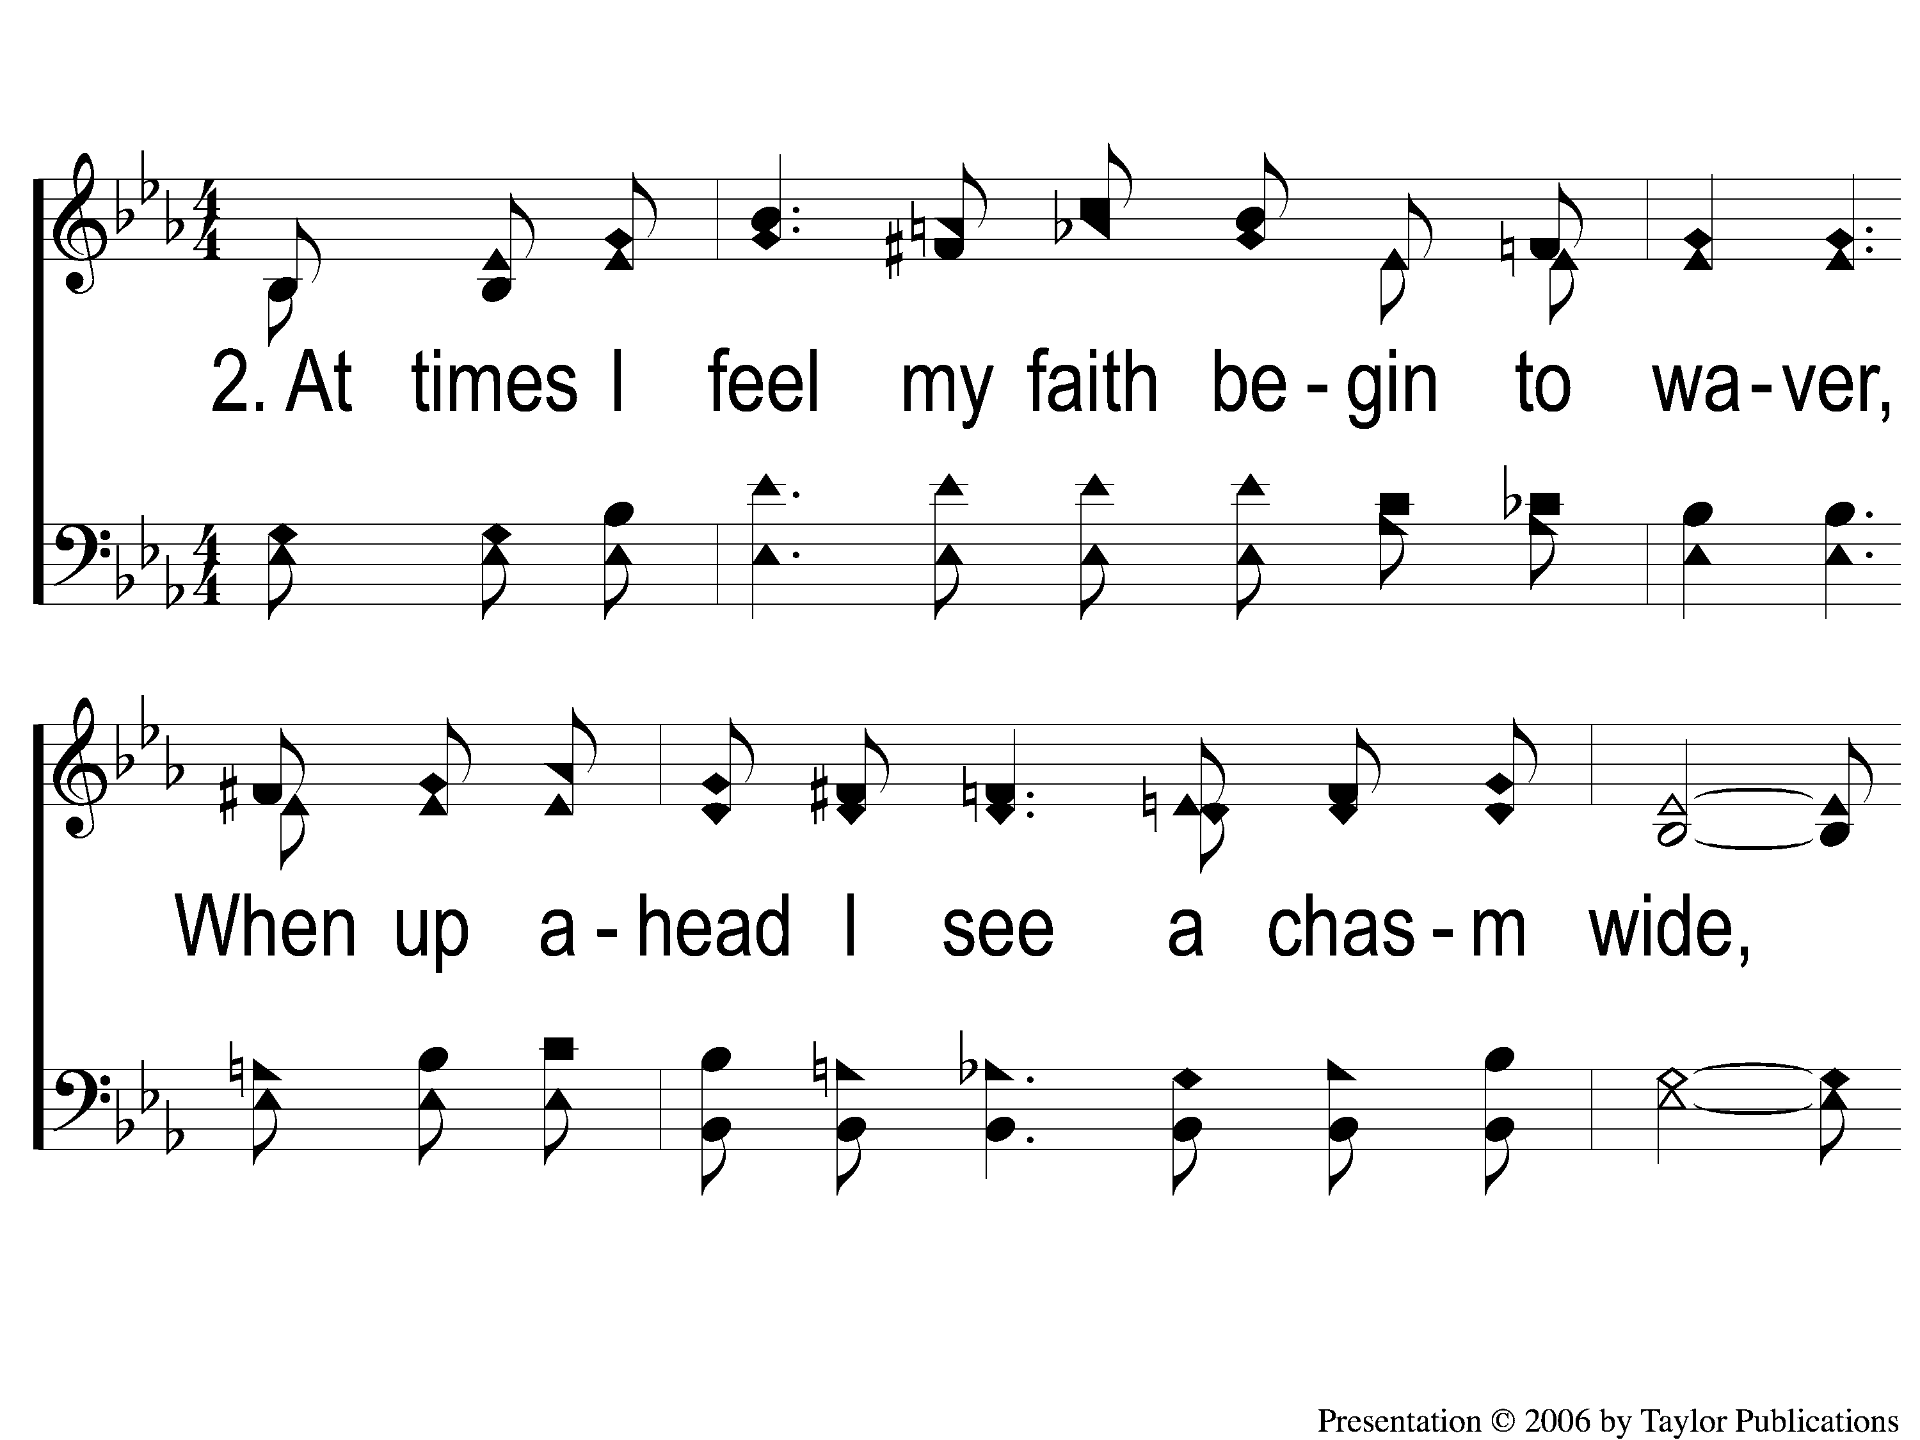
2-1 Each Step I Take
Each Step I Take
94

Slide 6
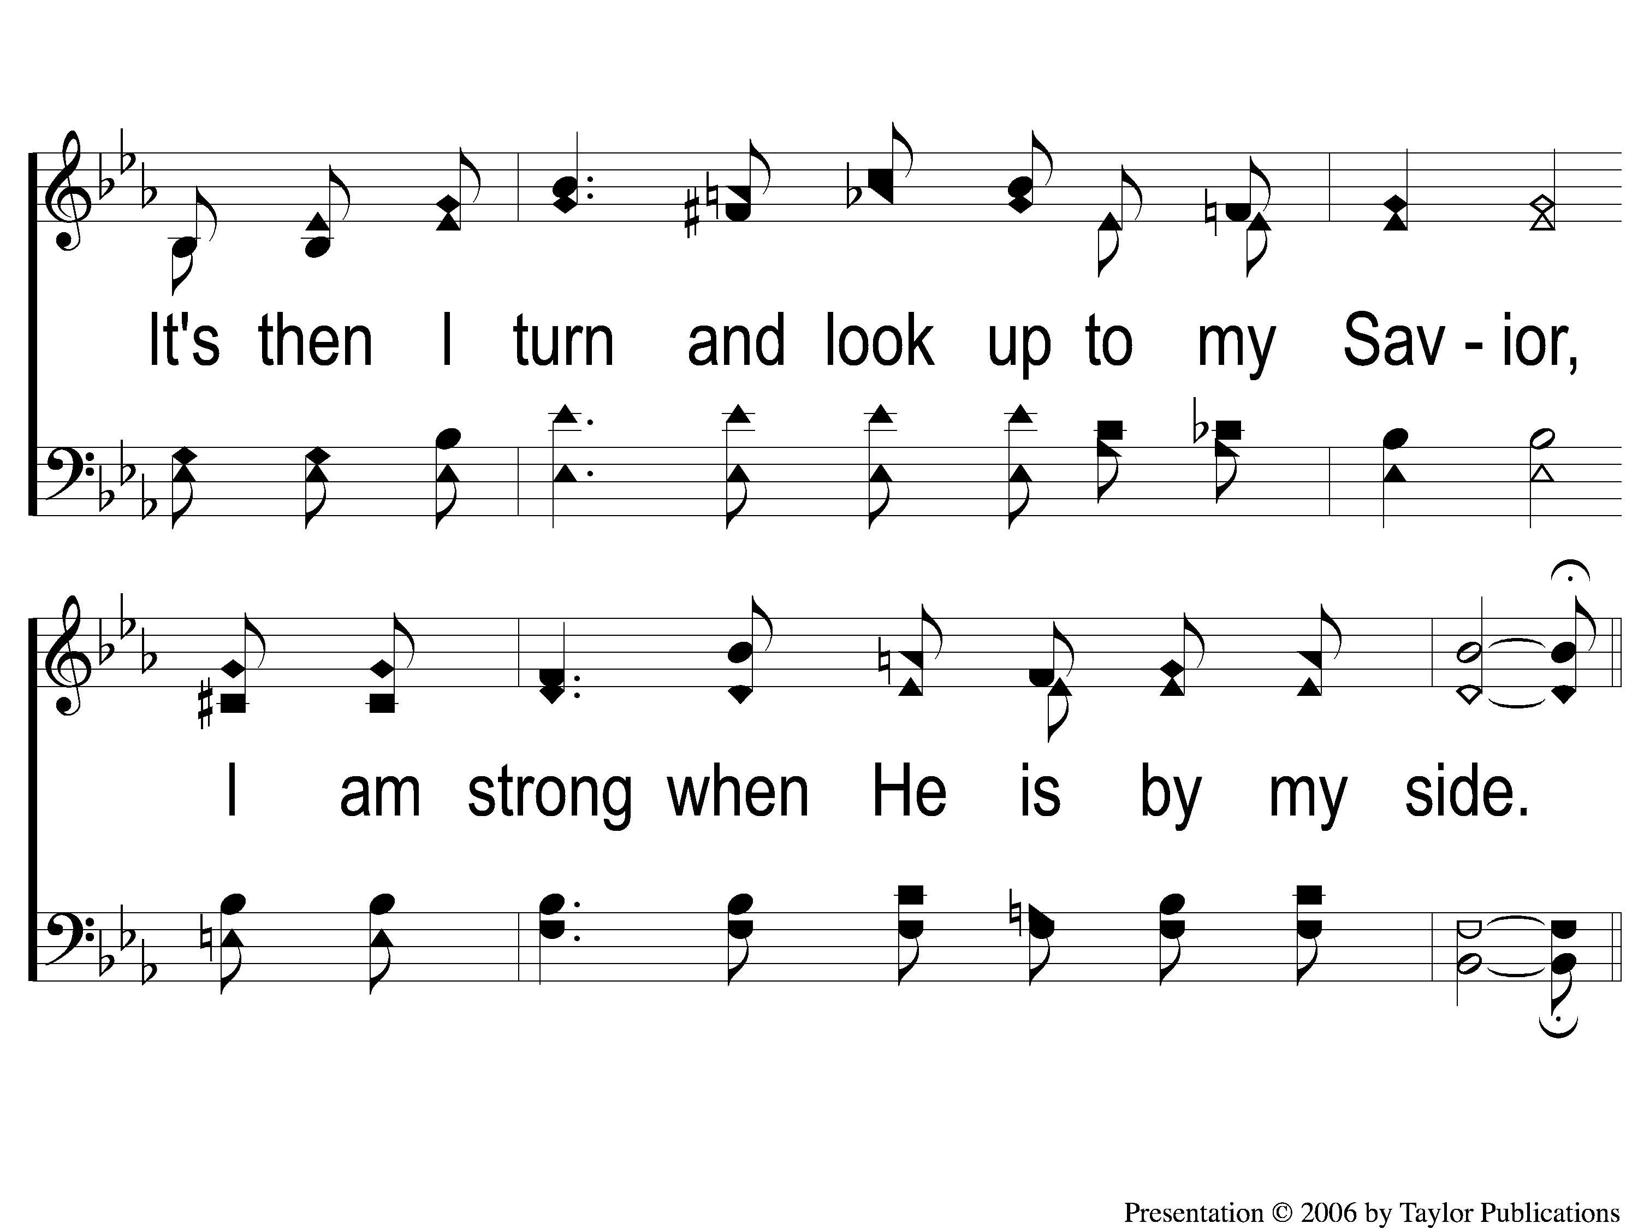
2-2 Each Step I Take
Each Step I Take
94

Slide 7
C-1 Each Step I Take
Each Step I Take
94

Slide 8
C-2 Each Step I Take
Each Step I Take
94

Slide 9
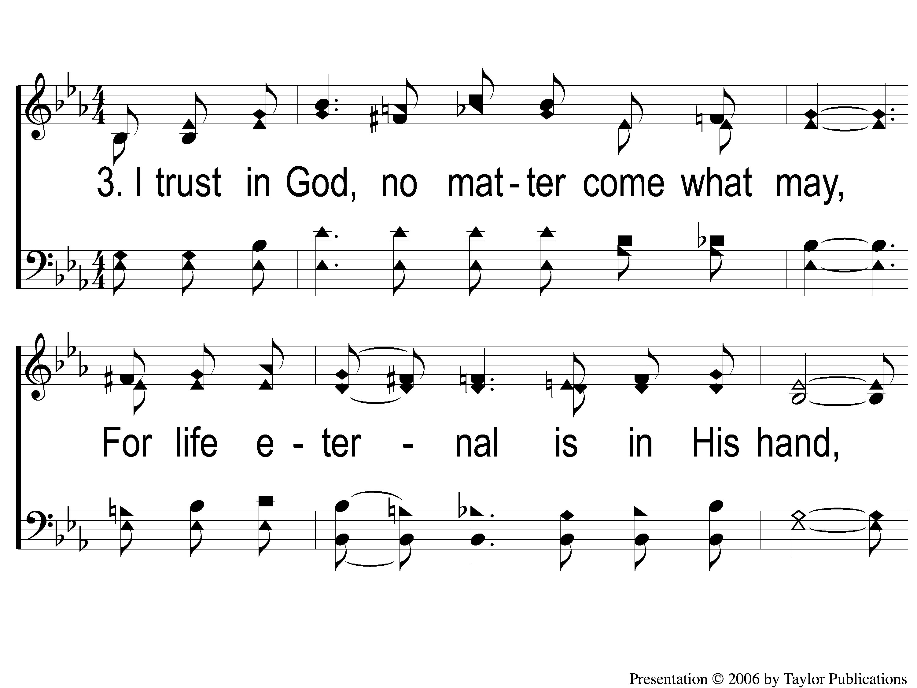
3-1 Each Step I Take
Each Step I Take
94

Slide 10
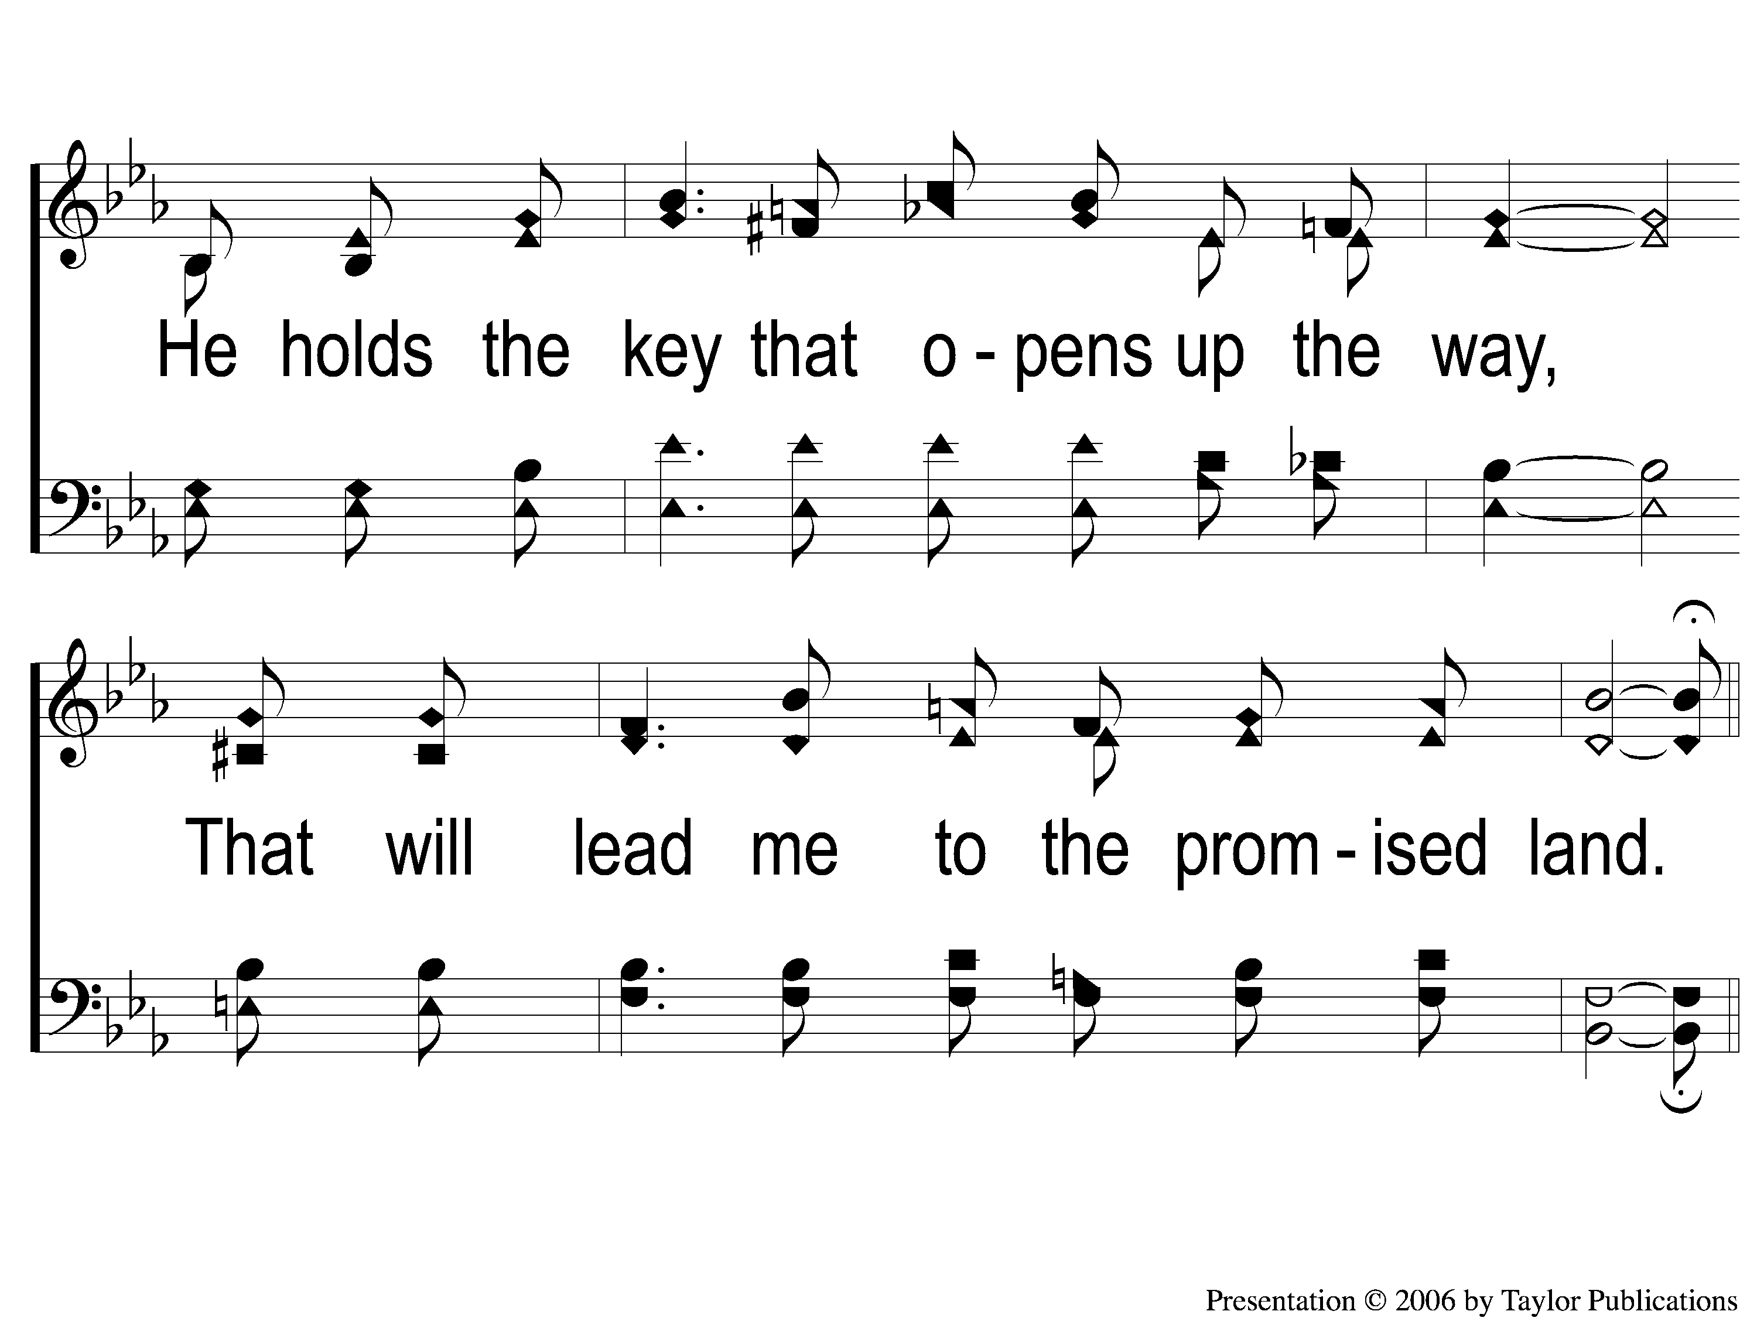
3-2 Each Step I Take
Each Step I Take
94

Slide 11
C-1 Each Step I Take
Each Step I Take
94

Slide 12
C-2 Each Step I Take
Each Step I Take
94

